Slide 1
Autonomous Mobile Manipulator
Project Execution Plan and IP Landscape presentation
Tom Queen and Daniel Gregory-Turner
Abstract / intro
Notes:
2 mins

Slide 2
Research Question
Can a compliant robot arm be integrated into a self-navigating robot platform and programmed to autonomously to identify, locate, grasp and transport objects using data from cascaded camera systems with comparable reliability to existing systems as a function of development time and cost?
Notes:
45 seconds

Slide 3
Research Objectives
Evaluate current methods of autonomous object fetching with respect to functionality and reliability as a function of cost
Explore methods of camera based object recognition and localisation from cascaded camera systems, and the interaction between these systems
Investigate and develop a novel approach to grasping a variety of objects
Build a system capable of autonomously navigating an environment, locating a desired object and transporting the object to a location with comparable reliability to existing systems as a function of development time and cost.
Notes:
One min

Slide 4
Project description and objectives
Requirements:
Object recognition
Object localisation
Navigate to object
Positioning gripper
Object grasping
Location storage
User interface
E.g:
Verbal?
Notes:
1:30

Slide 5
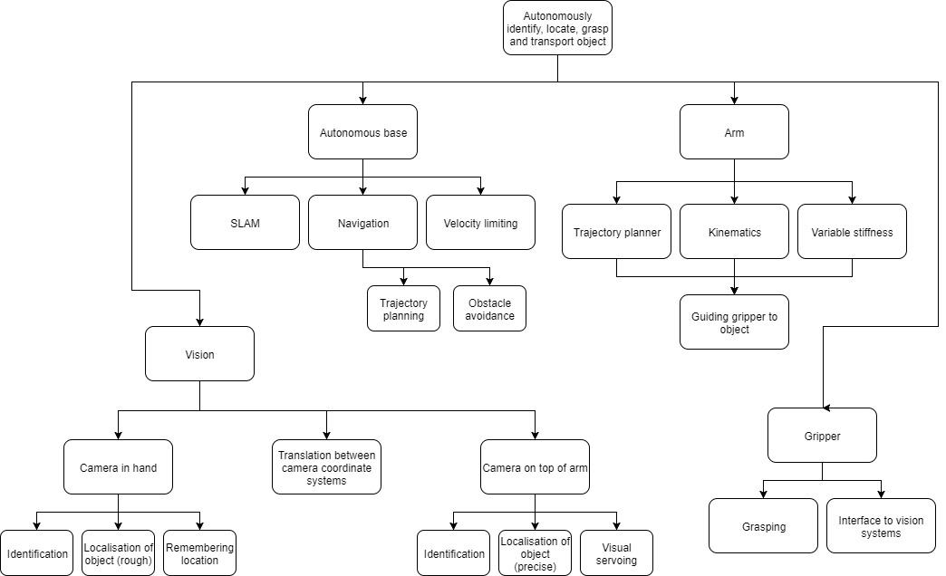
Systems Breakdown
Notes:
30 secs

Slide 6
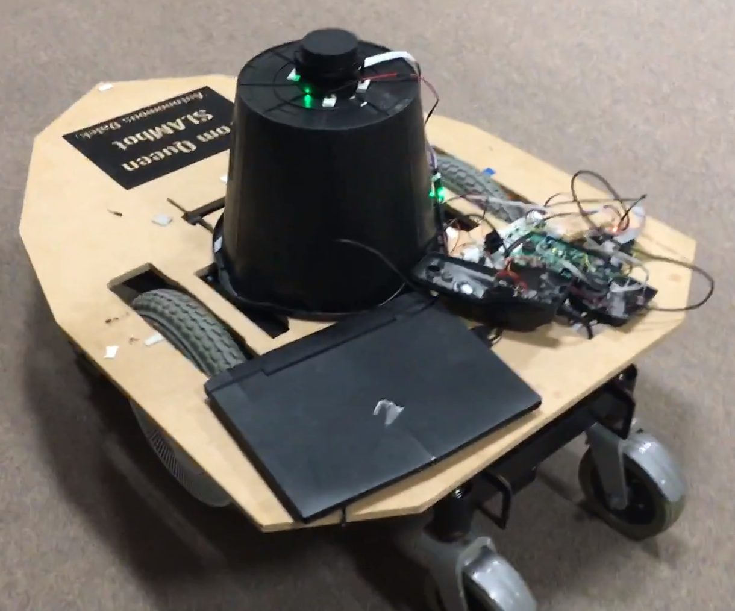
Systems overview
Hardware
Arm
Base
Gripper
Cameras
Software
ROS
Vision algorithms
Waypoint node
Control
Notes:
2:30

Slide 7
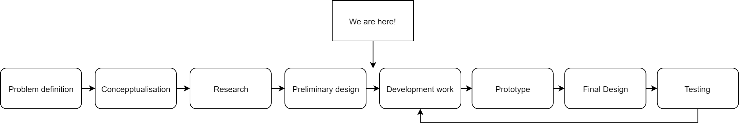
Design Process
Testing examples

Slide 8
Project Management
Example - Systems architect:
High-level design of system architecture
Identifying and specifying requirements of software subsystems
Structuring software subsystems
Specifying requirements of subsystem interfaces
Testing the interaction between subsystems
Philosophy:
Traditional project management theory
Adaptive path method
Roles and Responsibilities
 | Project manager | Electrical manager | Mechanical manager | Software manager | Systems architect | Financial manager
Tom | X | X |  |  | X
Daniel | X |  | X | X |  | X

Slide 9
Risk Management
Brainstormed potential risks to project
Gave each risk a probability and impact score
Risk priority is the product of the probability of the risk occurring and its potential impact

Slide 10
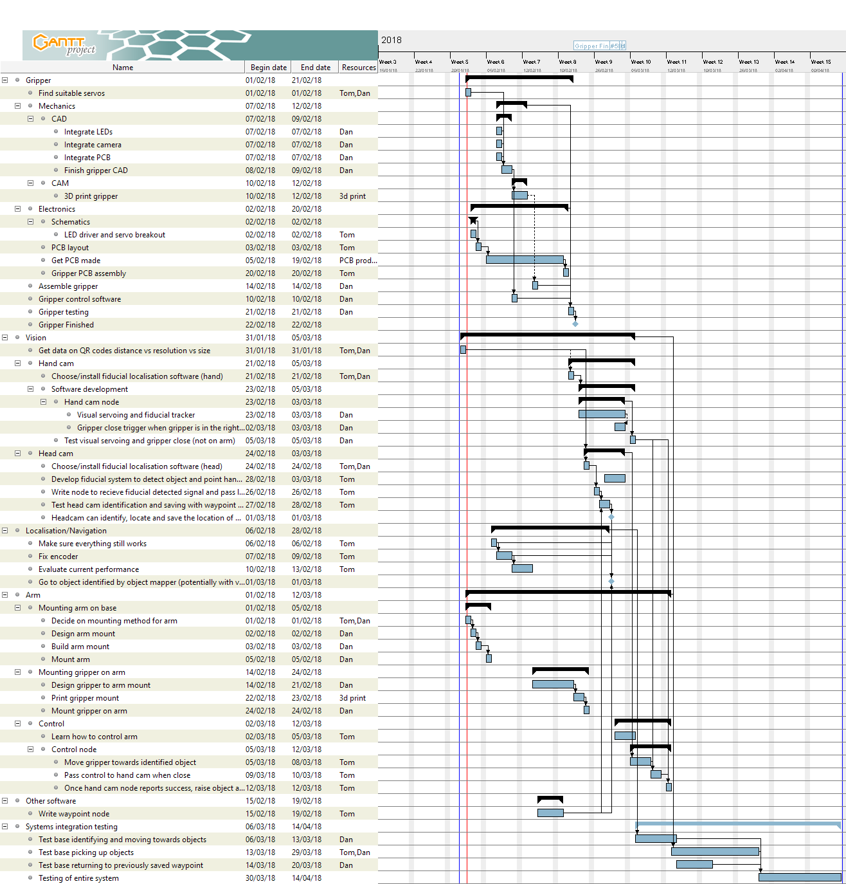
Time plan

Slide 11
IP Landscape
Generalness regarding robotic systems:
All SLAM robots
Aquire, process, visualise
General Gripper

